Slide 1
Sorting in Parallel
Week 6

Slide 2
Scalability
Programs that can maintain a constant efficiency without increasing the problem size with increase in number of processes are sometimes said to be strongly scalable.
Programs that can maintain a constant efficiency if the problem size increases at the same rate as the number of processes are sometimes said to be weakly scalable.

Slide 3
Parallel Sort, what does it means?
9 | 2 | 4 | 7 | 1 | 3 | 6 | 5
1 |  | 2 |  | 3 |  | 4
1 | 2 | 3 | 4 | 5 | 6 | 7 | 9
Data on different processors gets sorted and remains on different processors

Slide 4
Parallel Sort, what does it means?
9 2 4 7 1 3 6 5
1 |  | 2 |  | 3 |  | 4
# | # | # | # | # | # | # | #
1 |  | 2 |  | 3 |  | 4
1 2 3 4 5 6 7 9
Data is on a single CPU get distributed and sorted and received back in initial CPU.

Slide 5
Recap into serial sorting algo
void Bubble_sort ( int a[], int n) {
int length, i, temp;
for (length = n ; length >= 2 ; length−−)
for (i=0; i<length−1; i++)
if (a[i]>a[i+1]){
temp = a[i];
a[i] = a[i+1];
a[i+1] = temp;
}
} /∗ Bubble_sort ∗/

Slide 6
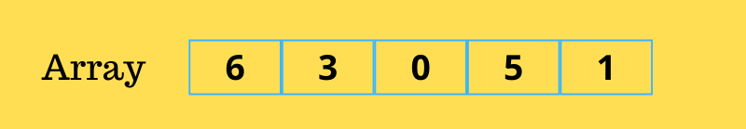
Bubble sort

Slide 7
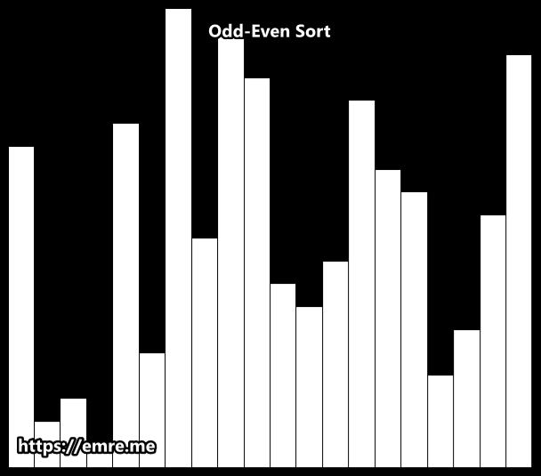
Odd Even Sort

Slide 8
Odd Even Sort
void Odd_even_sort ( int a[], int n) {
int phase, i;
for (phase = 0; phase < n ; phase++)
if (phase%2 == 0){ /∗ Even phase ∗/
for (i=1; i<n ; i+=2)
if (a[i−1]>a[i]) {
Swap(a,i,i-1);
}
}else { /∗ Odd phase ∗/
for ( i = 1; i < n−1; i += 2)
if (a[i]>a[i+1]) {
Swap(a,i,i+1);
}
}
}/∗ Odd_even_sort ∗/
Swap(int arr[],int i,int j)
{
int temp = a[i];
a[i] = a[j];
a[j] = temp ;
}

Slide 9
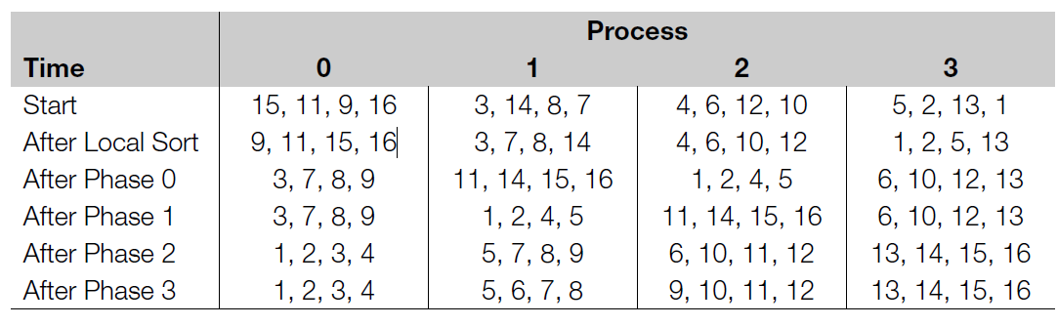

Slide 10
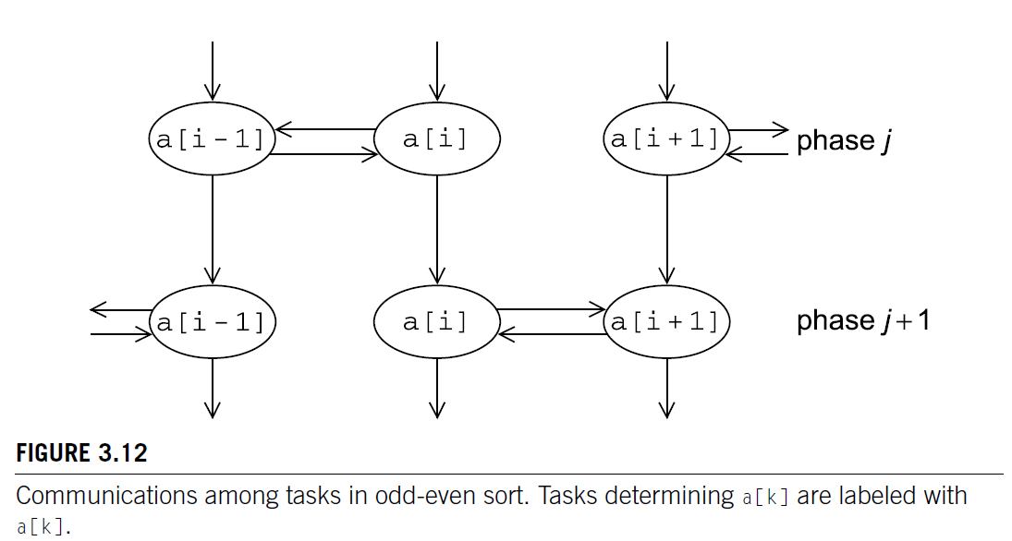

Slide 11
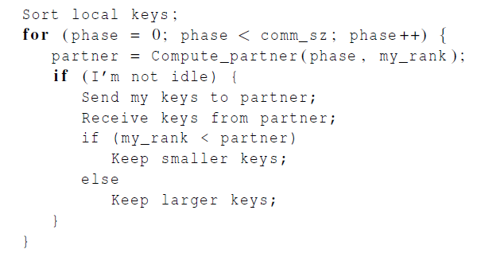

Slide 12
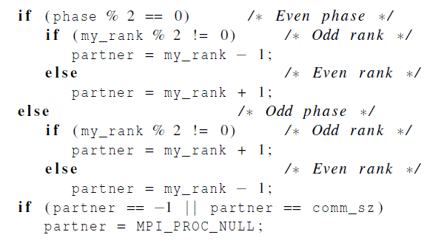

Slide 13
Can you spot the problem with MPI_Send ????
The MPI standard allows MPI_Send to behave in two different ways:
it can simply copy the message into an MPI managed buffer and return,
or it can block until the matching call to MPI_Recv starts.

Slide 14
Deadlock - Dining Philosophers Problem
If the MPI_Send executed by each process blocks, no process will be able to start executing a call to MPI_Recv, and the program will hang or deadlock.
Each process is blocked waiting for an event that will never happen.

Slide 15
Unsafe MPI Programs
A program that relies on MPI provided buffering is said to be unsafe.
Such a program may run without problems for various sets of input, but it may hang or crash with other sets.

Slide 16

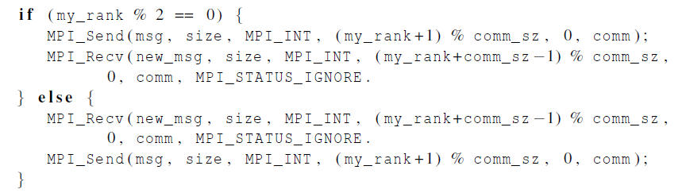
Alternative: Reorder the send recv

Slide 17
Why leave it to the programmer: MPI_Sendrecv
An alternative to scheduling the communications ourselves.
Carries out a blocking send and a receive in a single call.
The dest and the source can be the same or different.
Especially useful because MPI schedules the communications so that the program won’t hang or crash.

Slide 18
MPI_Sendrecv
Input Parameters
sendbuf: address of send buffer (choice)
sendcount: number of elements (non-negative integer)
sendtype: type of elements
dest: rank of destination (integer)
sendtag: send tag (integer)
recvcount: number of elements (non-negative integer)
recvtype: type of elements
source: rank of source
recvtag: receive tag or MPI_ANY_TAG (integer)
comm: communicator (handle)
Output Parameters
recvbuf
initial address of receive buffer (choice)
status
status object (Status)

